Slide 1
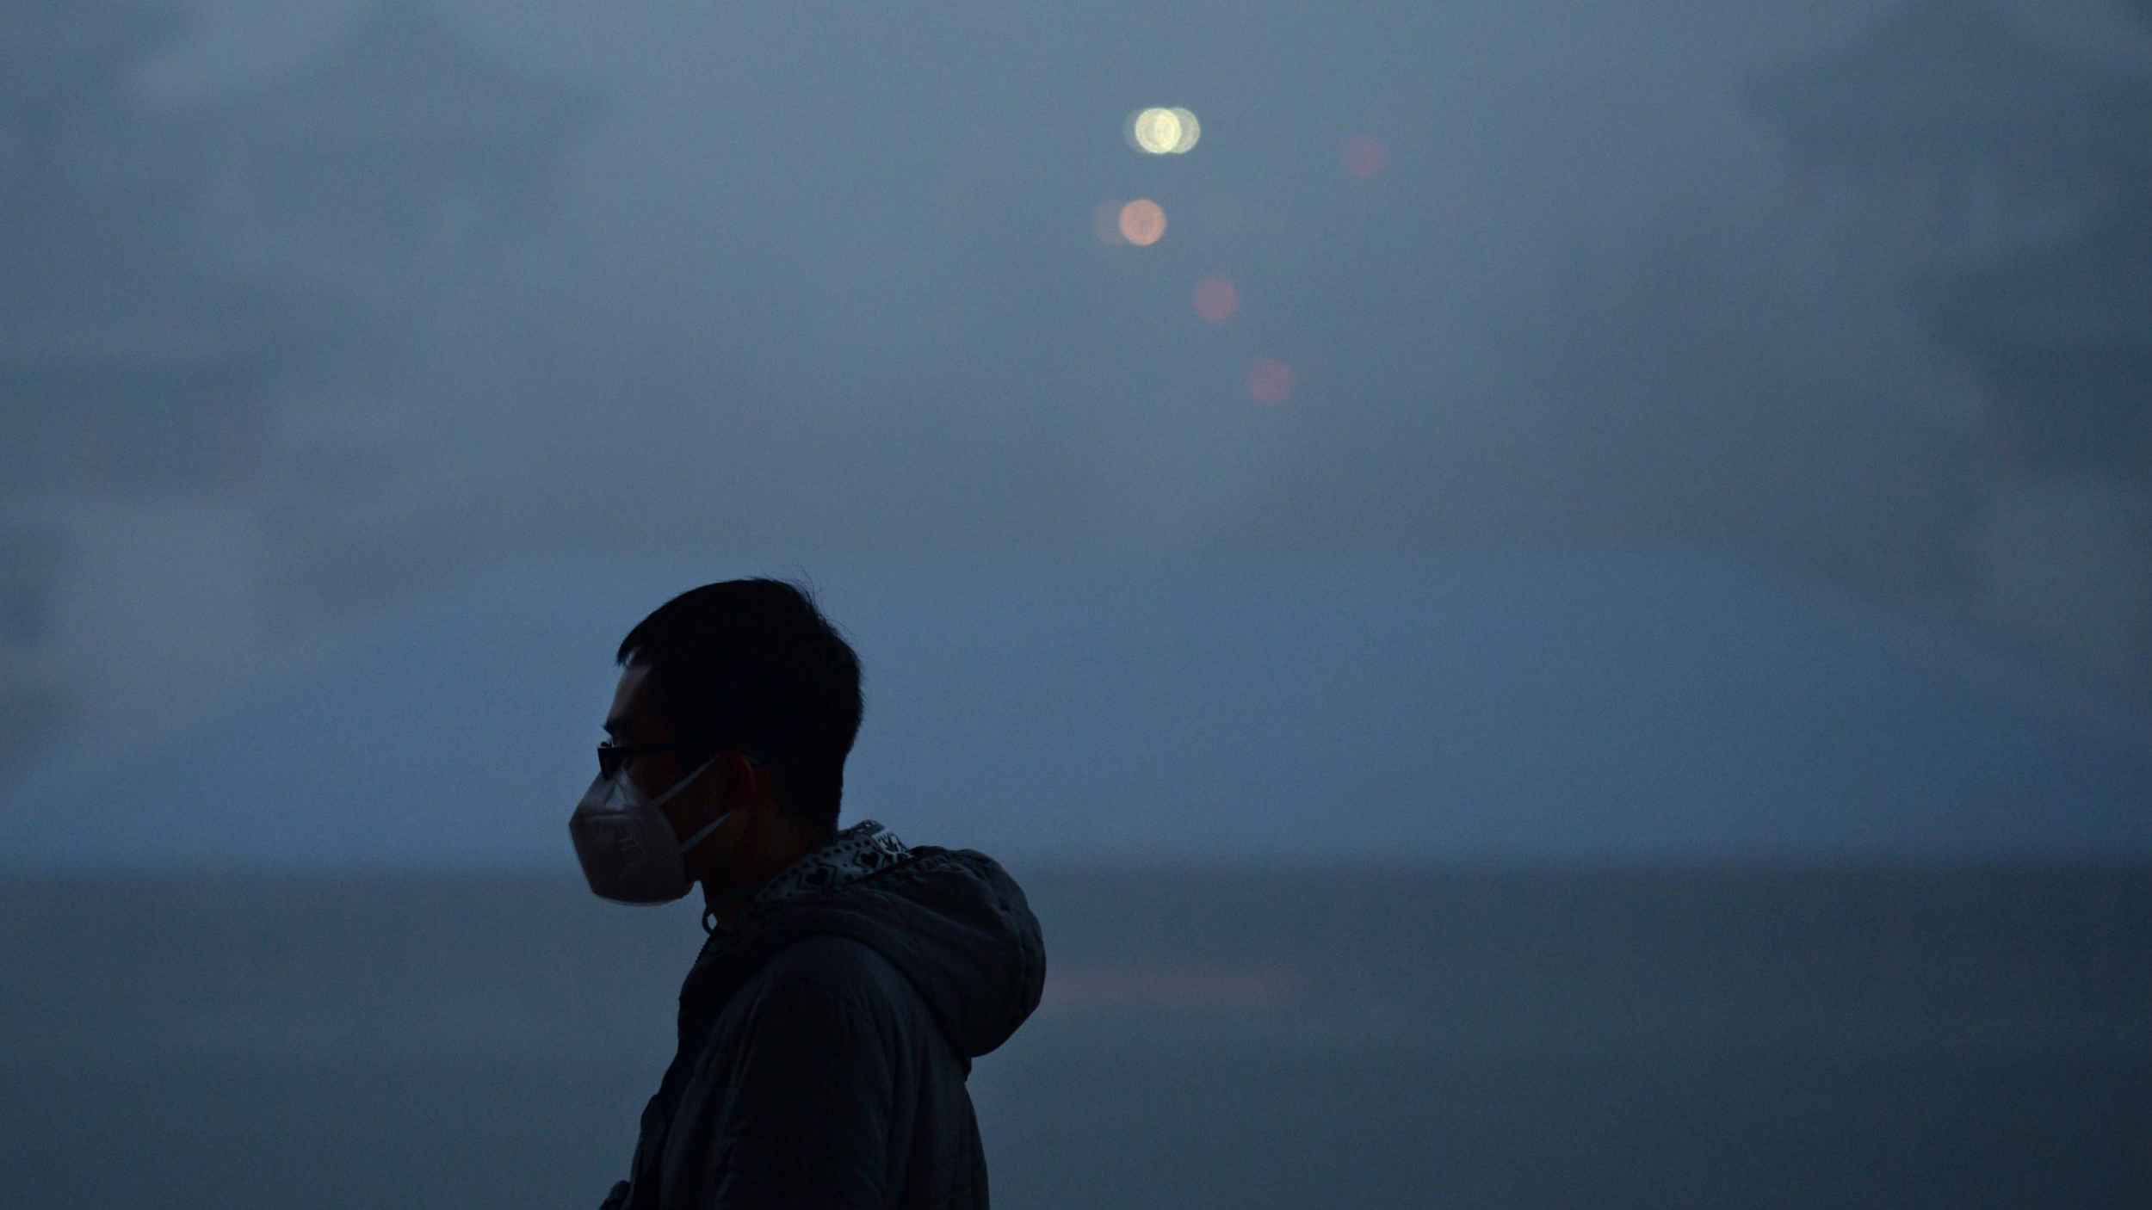

Air Pollution
Fordham University
Jie Teng
Ila Srivastava
Leslie

Slide 2



Data Source

Slide 3
Mortality Rate

Slide 4

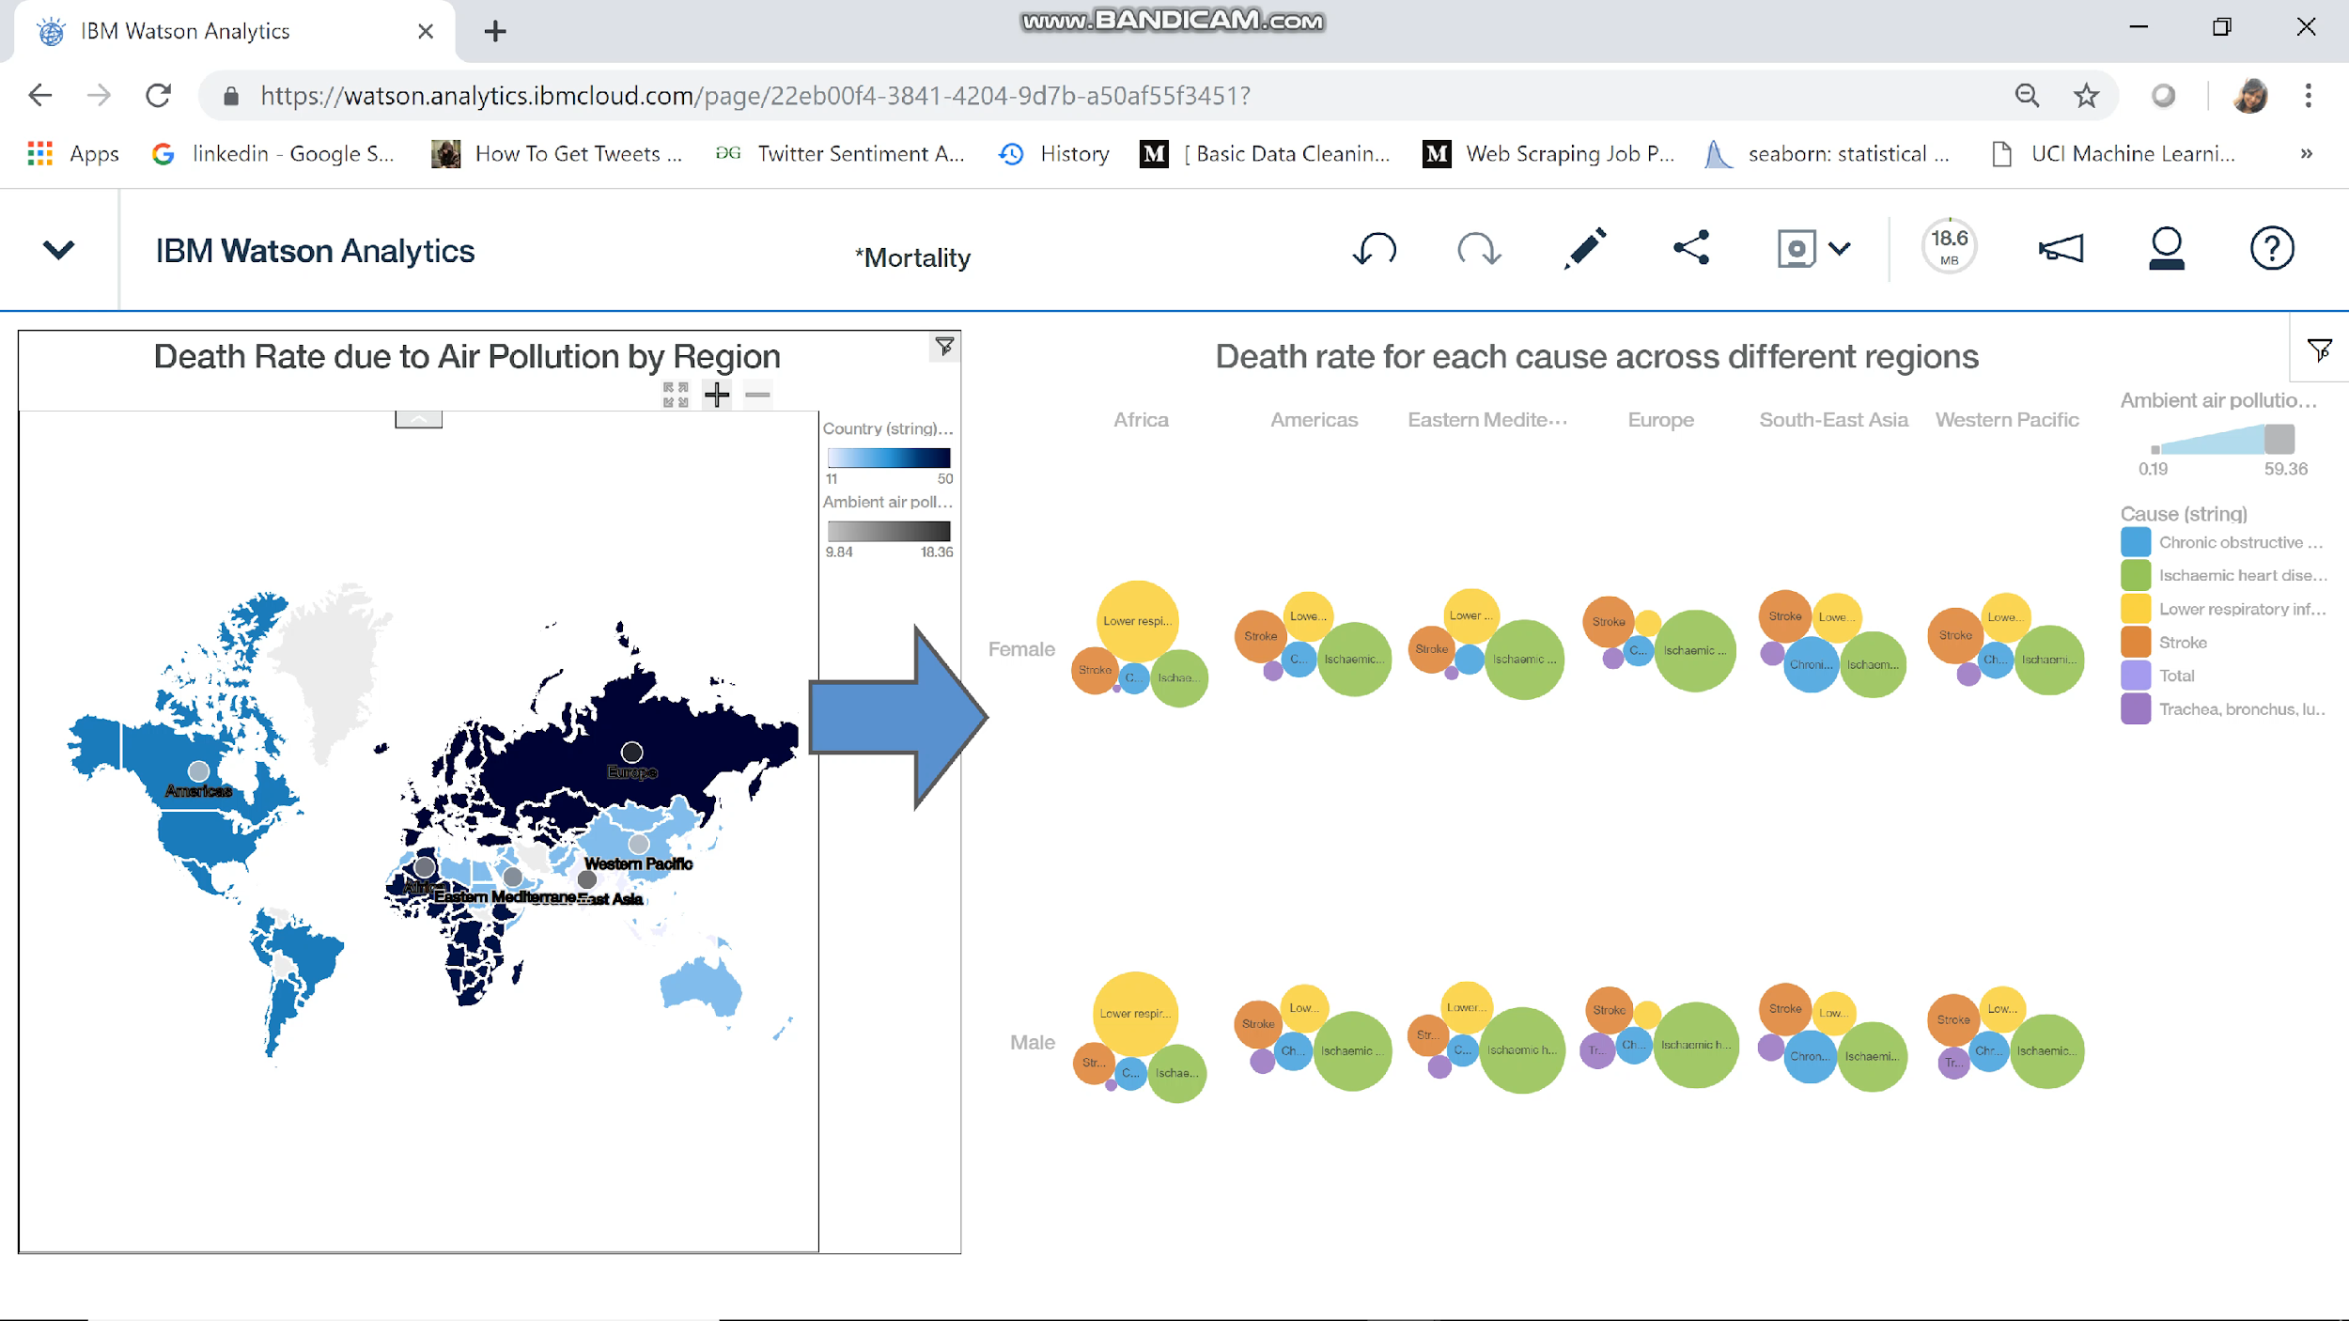

Slide 5
Mortality rate for children under 5 years

Slide 6
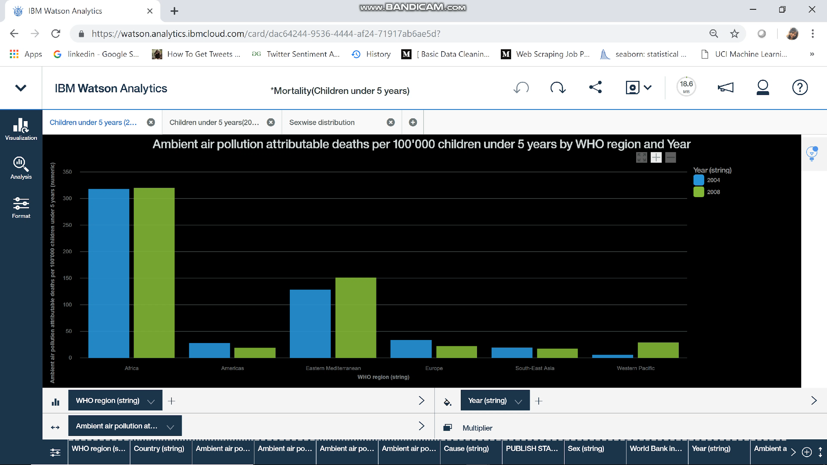

Slide 7
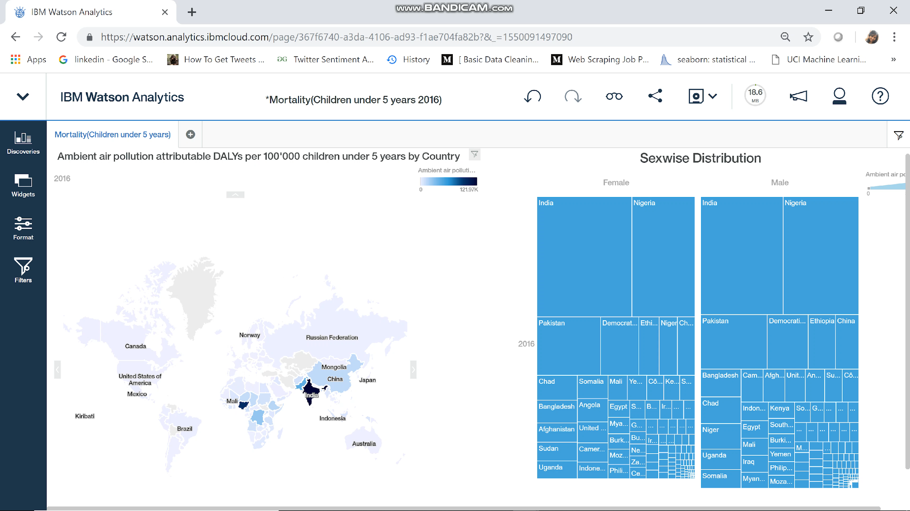

Slide 8
PM2.5

Slide 9
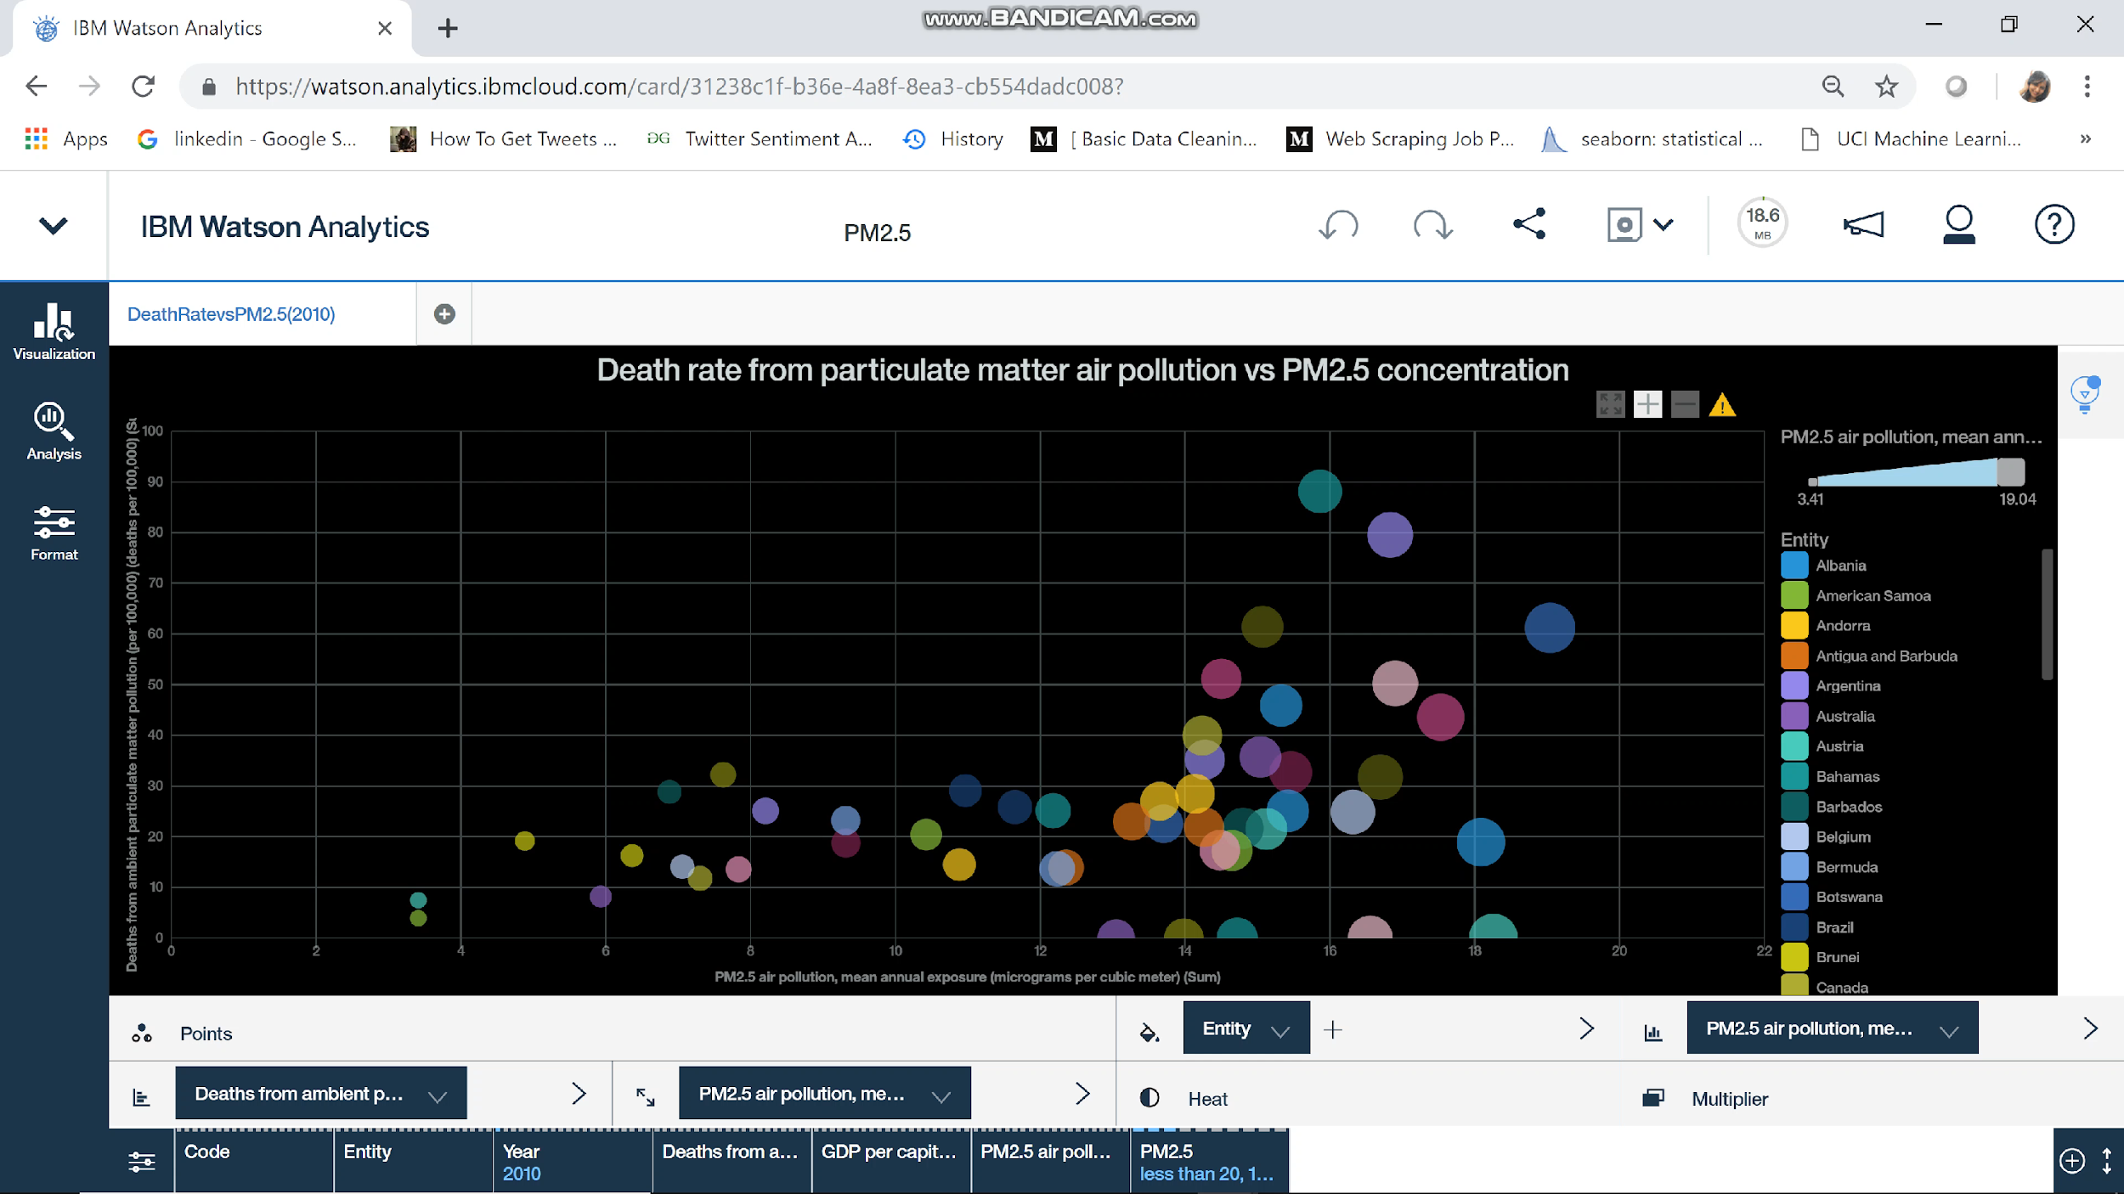

Slide 10
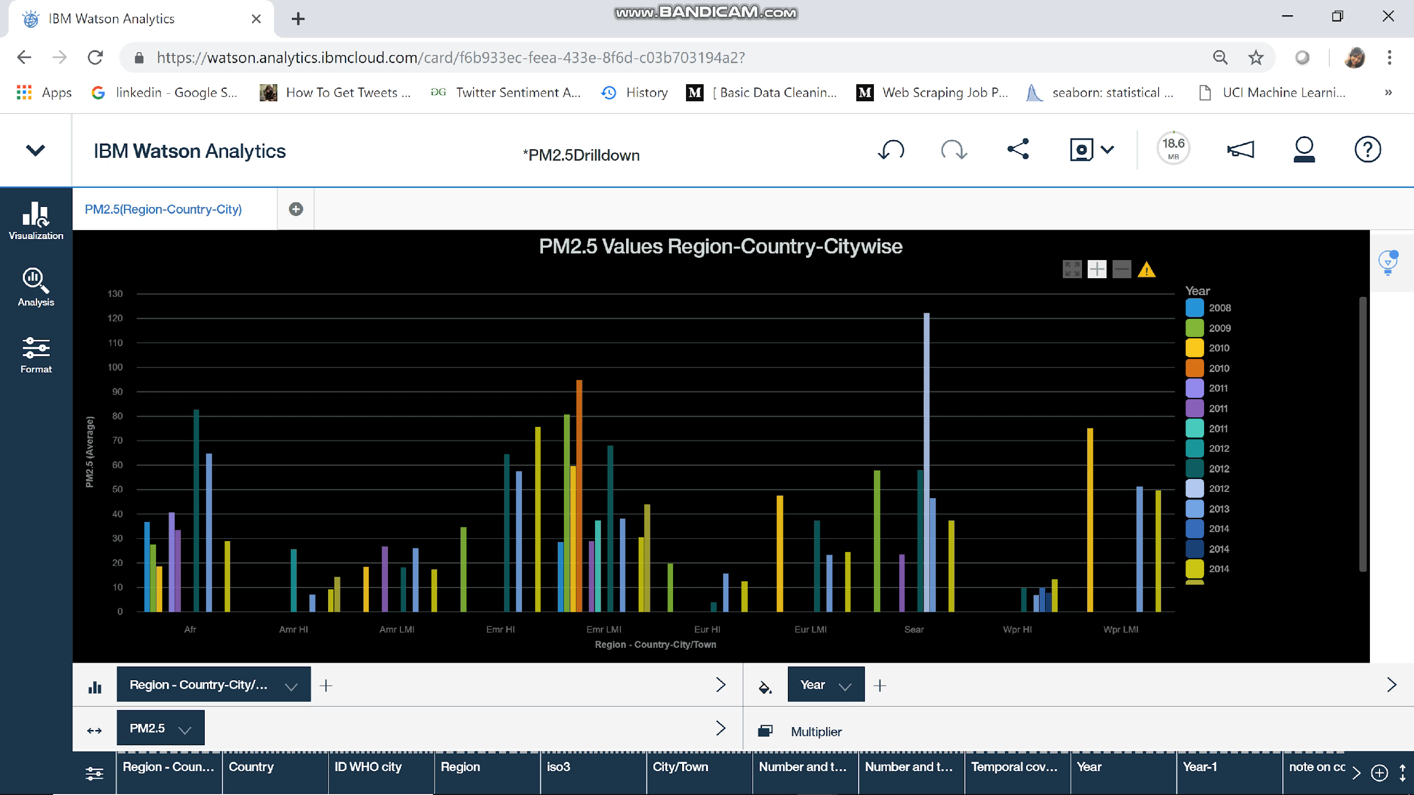

Slide 11
Pollutants

Slide 12
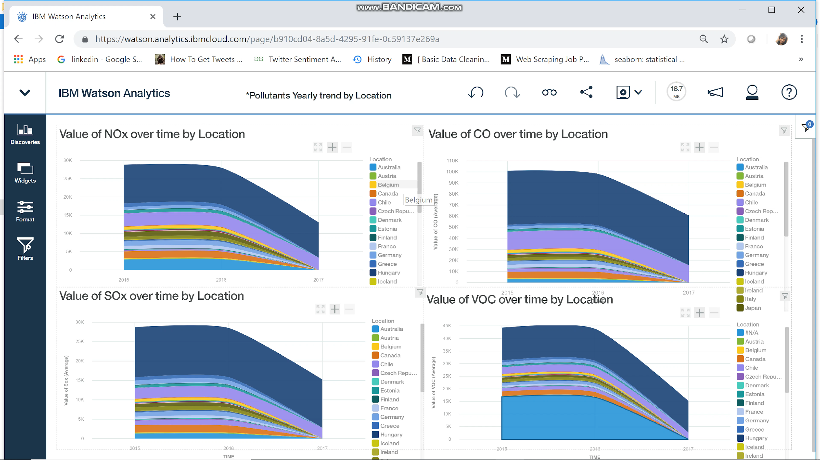

Slide 13
SO2 emission in India and China

Slide 14
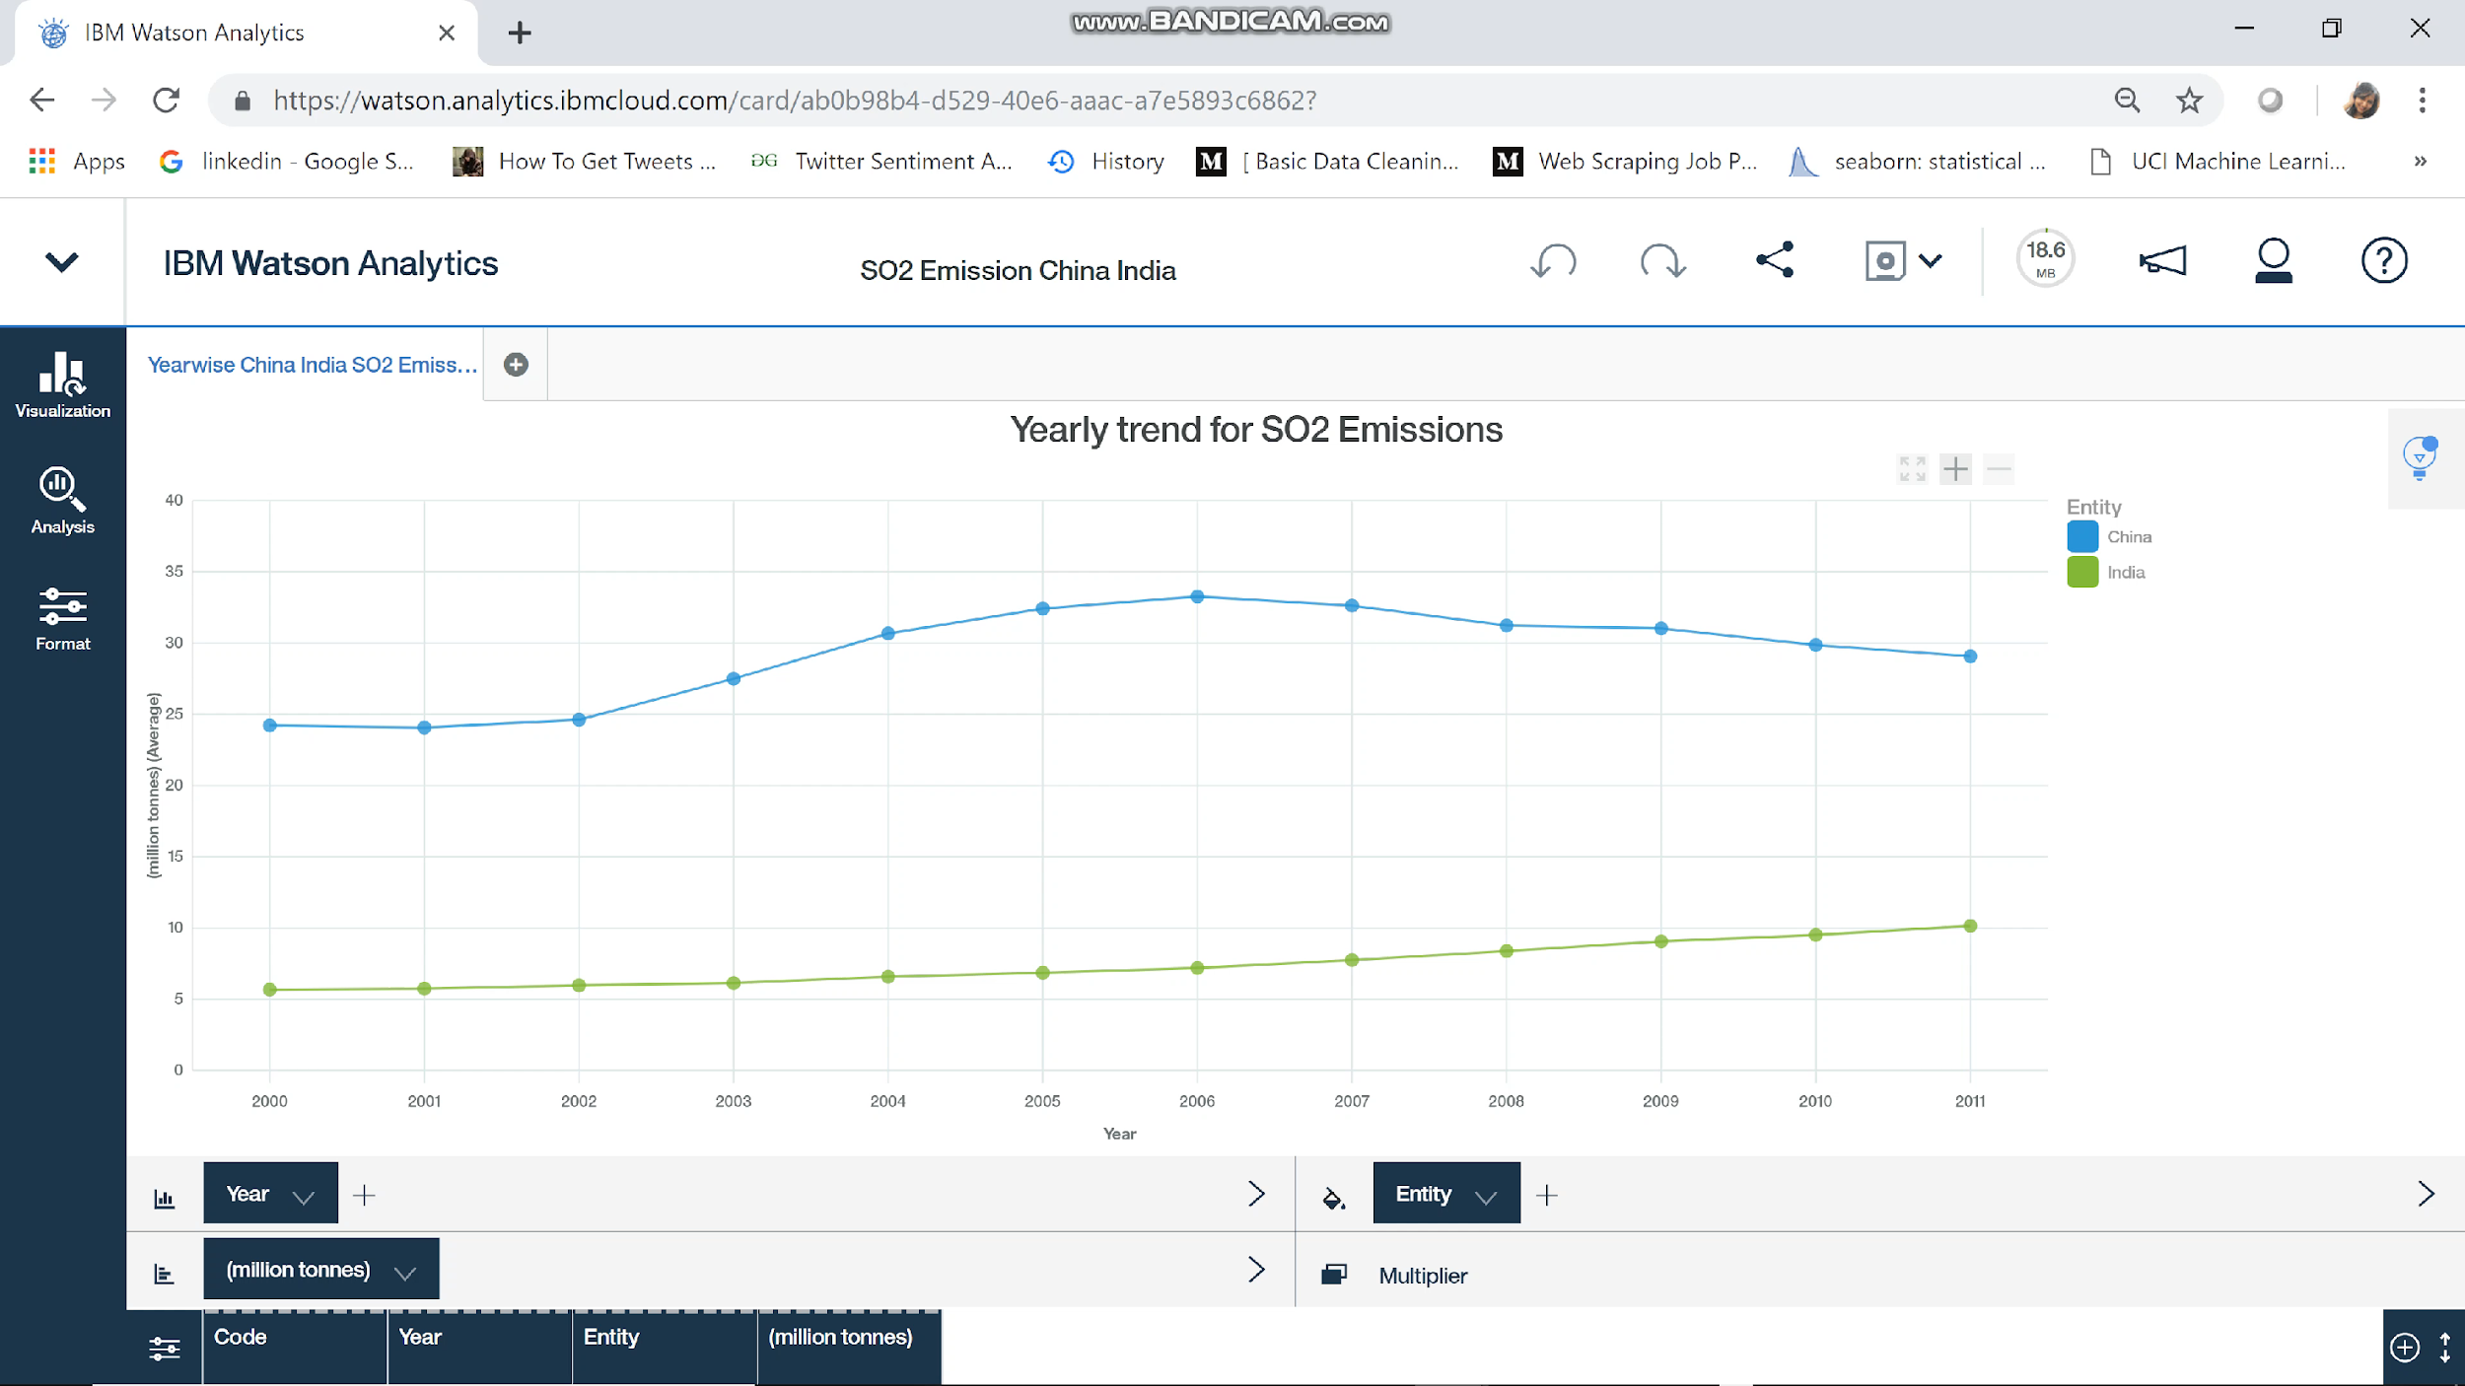

Slide 15
Pharmaceutical Spending

Slide 16
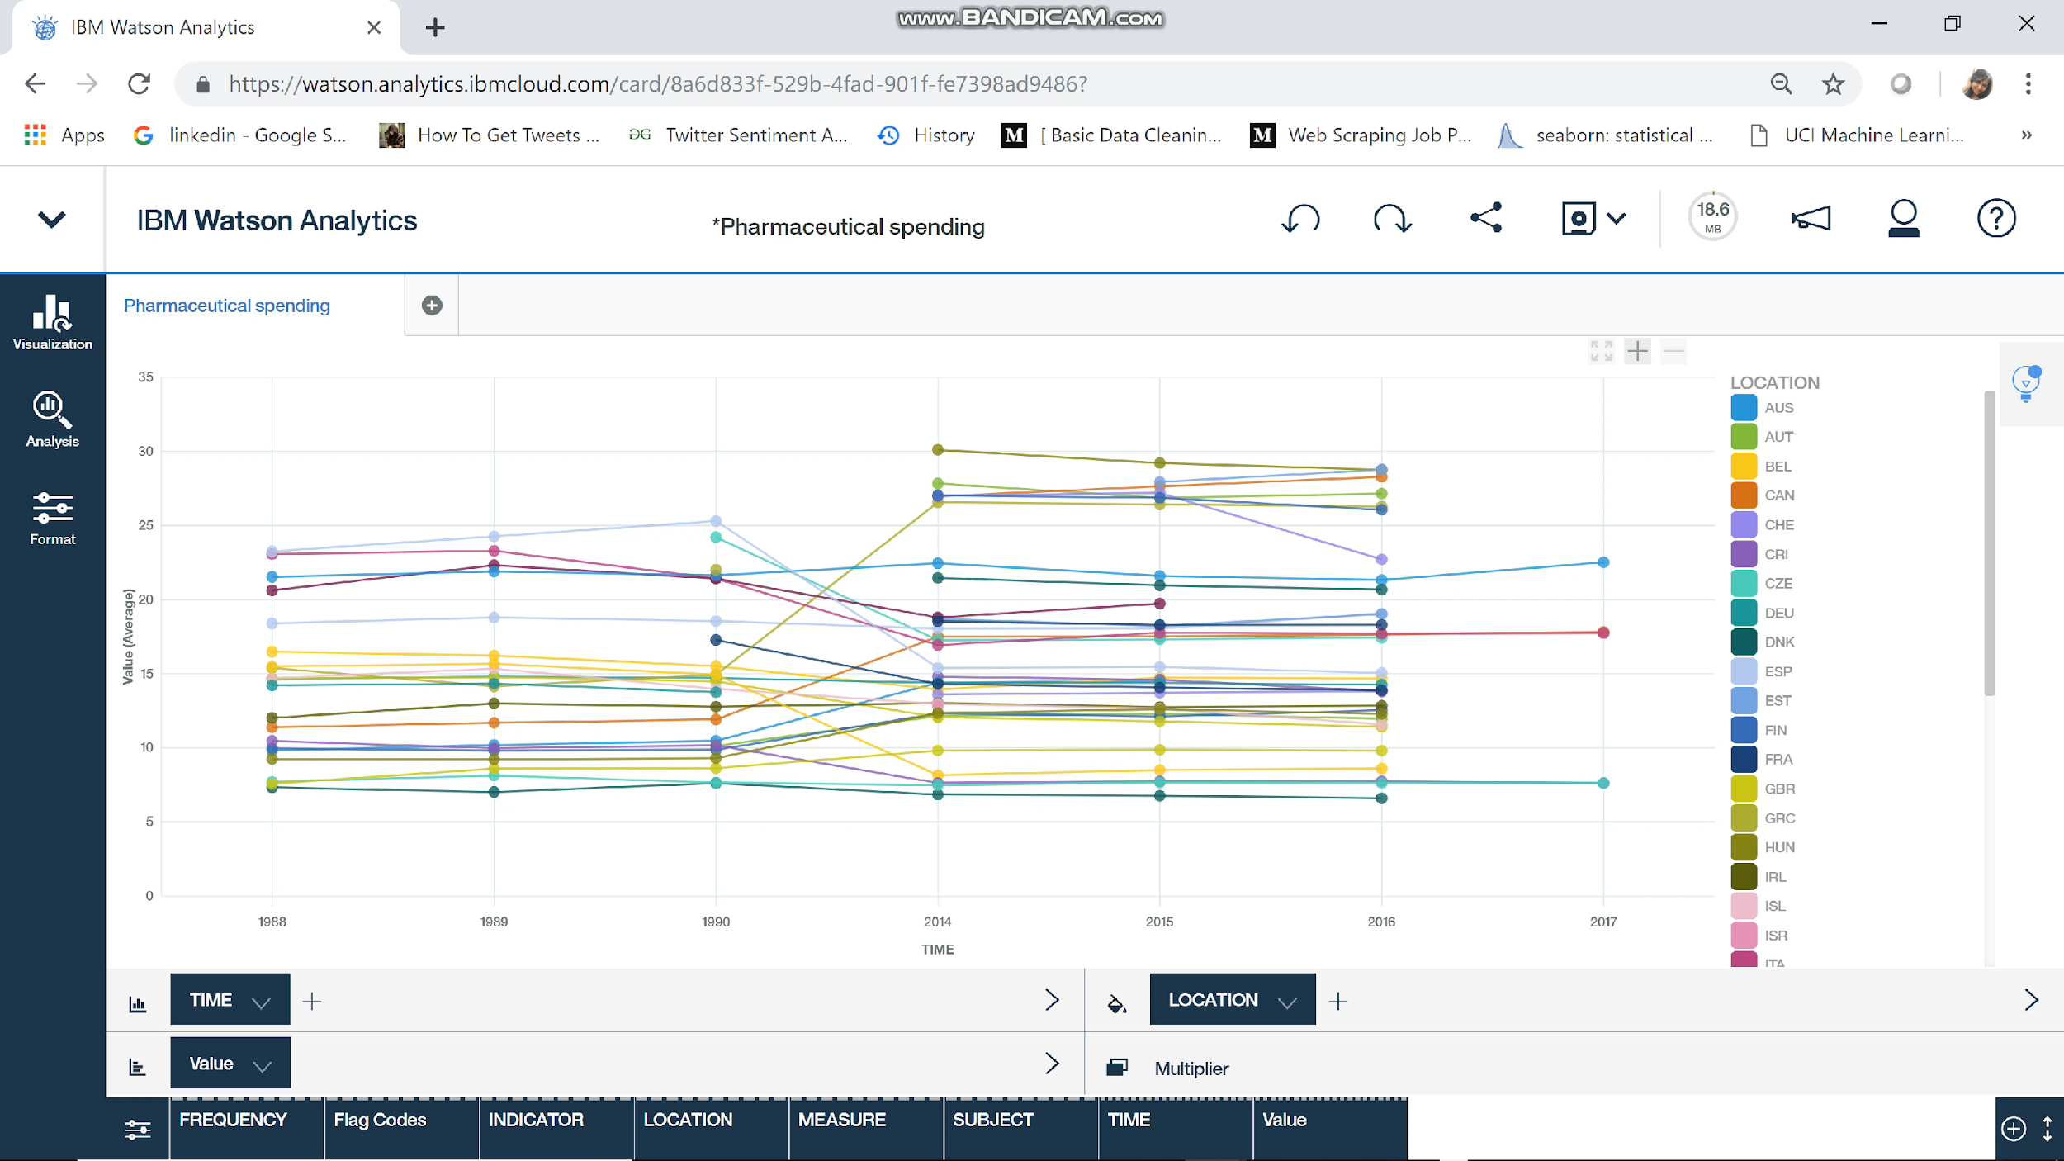

Slide 17
Forest Cover by Income level

Slide 18
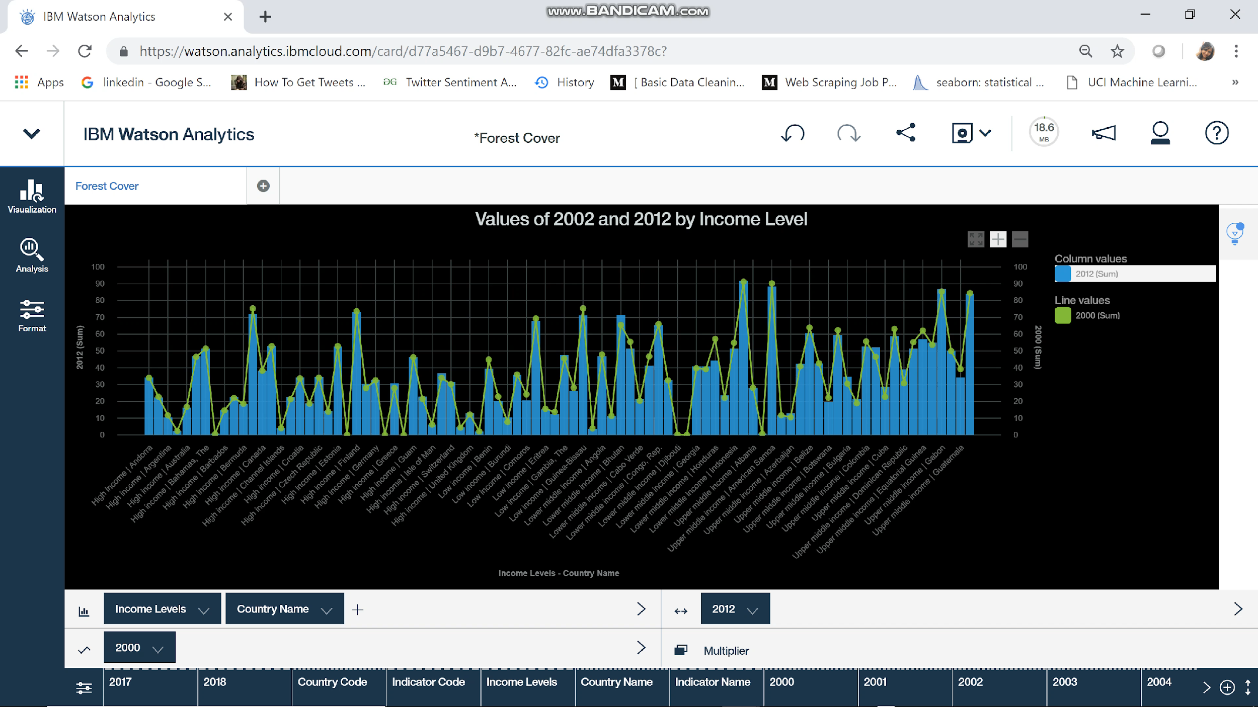

Slide 19
Electricity

Slide 20
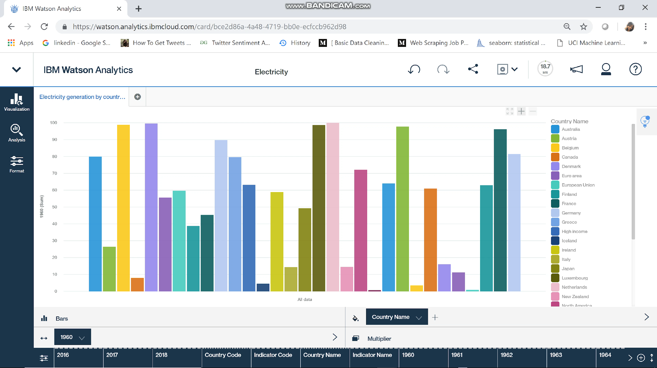

Slide 21
Effcet on India and China

Slide 22
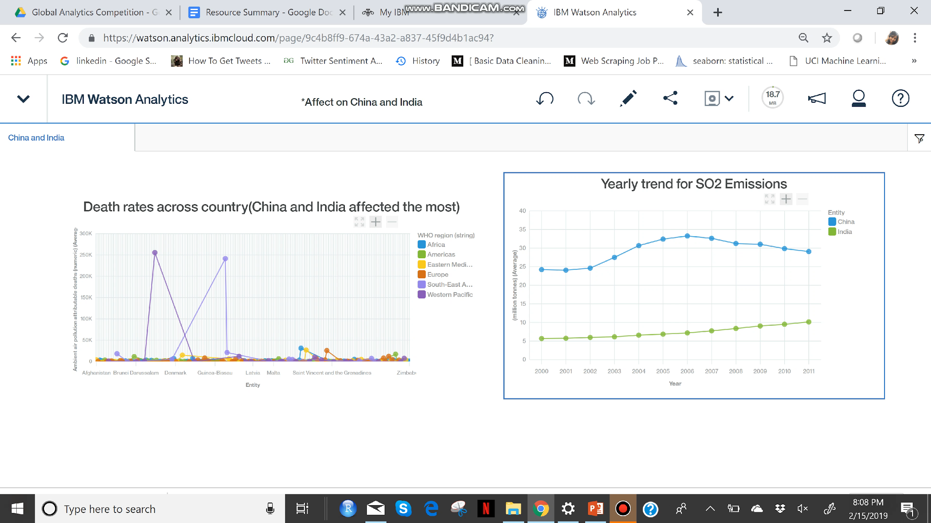

Slide 23
Recommendations

